Slide 1

The Adaptive Radix Tree: ARTful Indexing for Main-Memory Databases
Jonas Fritsch
Technische Universität München
TUM Department of Informatics
Chair for database systems
Munich, 11. July 2022

Slide 2
Overview
Disk-Based vs. Main-Memory DBMS
Index-Structures in DBMS
From Tries to ART
Key Transformations for Bitwise Comparisons
Benchmarks
Summary & Conclusion
Notes:
General Overview:
Quick introduction of „current“ (over last decade) trend from disk-oriented to main-memory DBMS
Quick recap on usage of index-structures in DBMS
Introduction of Tries, Radix-Trees, (Judy-Arrays as first adaptive radix tree) and ART datastructure
Benchmarks comparing ART
Summary & Conclusion

Slide 3
Disk-Based vs Main-Memory DBMS
Source: OLTP through the looking glass, and what we found there. SIGMOD, 2008
Notes:
DRAM capacities large enough to fit most structured databases.
Database architecture designed for disk-based DBMS to avoid disk I/O bottleneck. (Elimination of Buffer Pool, B+-Tree Design optimized for Buffer Pool etc.)
Disk I/O bottleneck non-existent in Main-Memory DBMS -> Adaptation of database architecture
-> One needed adaptation is to used index-structures.
Graphic:
Experiment described in paper.
Taking original disk-based DBMS (Shore), placing it in Main-Memory and running TPC-C Benchmark recording time spent in major components.
(Speedup by factor 20 when stripping away/refactoring unnecessary components)

Slide 4
Index-Structures in DBMS
Data structures used to quickly find data in table via a key
2 Index-Types:
Order Preserving Indexes (Maintains keys in sorted order)
Hashing Indexes (Associative array mapping hash of key to data record. Only supports equality predicates!)
Notes:
Instead of scanning through whole table in linear time utilize index structure to locate data more quickly
B/B+-Tree as most famous Order Preserving Index example.
ART as Order Preserving Index (based on Tries)

Slide 5
Tries
Keys:
HELLO,
HAT,
HAVE
H
A
E
T
V
L
E
L
O
Notes:
Note: characters normally represented on edges

Slide 6
Tries – Properties
Keys:
HELLO,
HAT,
HAVE
H
Properties:
Height/complexity depends on key length k instead of number of elements
Require no rebalancing
All insertion orders results in same tree
Keys stored in lexicographic order
Keys are stored implicitly along paths
A
E
T
V
L
E
L
O
Notes:
Note: as Index-Structure leaf nodes store pointer to table entry or TID etc.

Slide 7
Tries – Implementation
Keys:
HELLO,
HAT,
HAVE
H
class Node {
bool is_leaf;
// ‘A‘ to ‘Z‘
Node* children[26];
}
A
E
T
V
L
H
C
D
E
…
Z
E
L
A
B
…
…
O
Notes:
Excessive memory usage due to a lot of null pointers allocating space.
One possible optimization: Use map instead of array (less memory but also less performance due to missing cache locality etc.)
(Or: Bitmap + Pointer List etc.)
Lots of other optimizations possible. e.g. General Prefix Tree (GPT)

Slide 8
Tries – Key Span, Fanout and Height
Keys:
HELLO,
HAT,
HAVE
0x48
Key Span s:
Number of bits each partial key represents (e.g. char is 8 bit span)
Fanout:
Size of children for a node
Determined by specific implementation but in general is 2^s
Height:
Max Height for k bit keys: ceil(k/s)
0x41
0x45
0x54
0x56
0x4C
0x45
0x4C
0x4F
Notes:
GPT: 4 bit span
Fanout with 2^Key Span can use binary representation of partial key directly as array index (no comparison but excessive memory usage)
For alphabet only fanout of 26 as only 26 different character words (a,…,z) instead of 2^8 = 256

Slide 9
Radix Trees
Keys:
HELLO,
HAT,
HAVE
H
H
A
ELLO
OR
A
E
T
VE
T
V
Tuple Pointer
Notes:
Also called Patricia-Trees.
Nodes with only 1 child get merged with parent. (Vertical Compression)
„Merging“ is implementation specific:
Store edge strings in constant space with two pointers (start & end string)
Index Structure: Just omit intermediate nodes and just optimistally assume the rest of the key will match (check with tuple entry or store full key at leaf) (lazy expansion)
Will take closer look at vertical compression techniques used by art

Slide 10
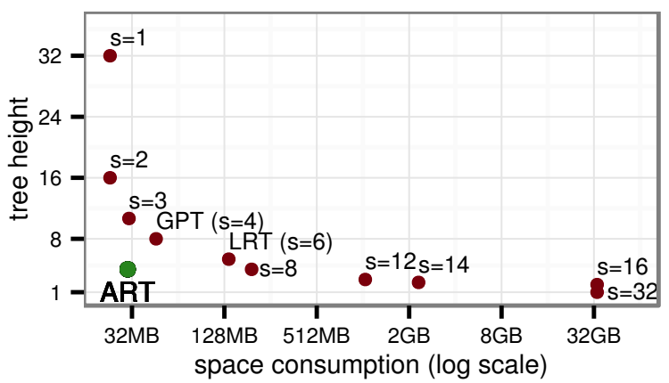
Height vs. Space Tradeoff
Source: The adaptive radix tree: ARTful indexing for main-memory databases. IEEE, 2013
Notes:
Utilize Radix Trees for vertical compression
What about horizontal compression? Size mostly dependent on fanout.
Graphic: Tree Height and space consumption for different values of the span parameter s when storing 1M uniformly distributed 32 bit integers.
General Prefix Tree (GPT): Span 4
Linux Radix Tree (used in Linux Kernel) (LRT): Span 6
ART: Span 8
How does ART manage to use so few memory with such a high span? -> Adaptive Nodes (Horizontal Compression)

Slide 11
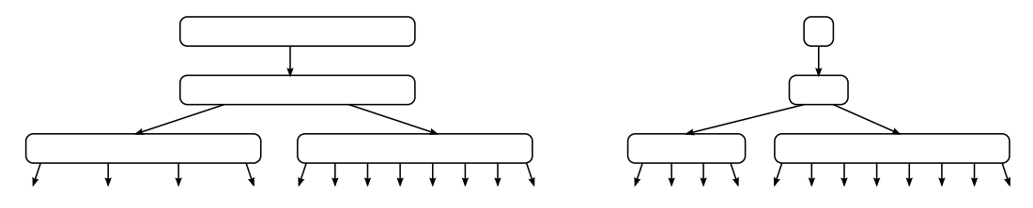
Adaptive Nodes
Main Idea:
Use different node types with different fanout based on number of non-null children.
Source: The adaptive radix tree: ARTful indexing for main-memory databases. IEEE, 2013
Notes:
First use of adaptive nodes (different fanouts) in Judy Arrays (associative array data-structure) (developed and patented in 2000 until January 2022)

Slide 12
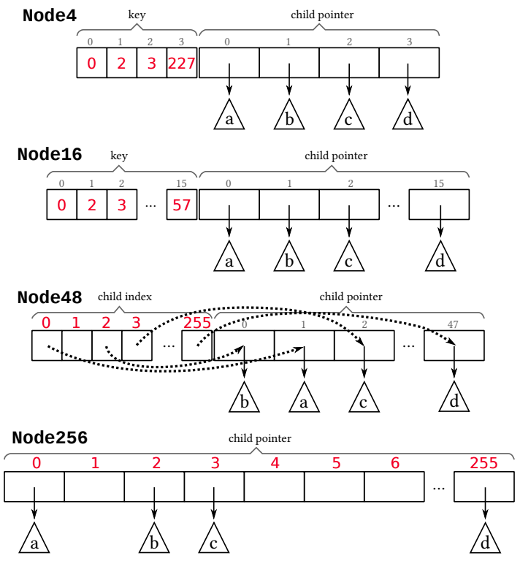
ART – Adaptive Nodes
Source: The adaptive radix tree: ARTful indexing for main-memory databases. IEEE, 2013
Notes:
ART uses 4 different node types with different capacities.

Slide 13
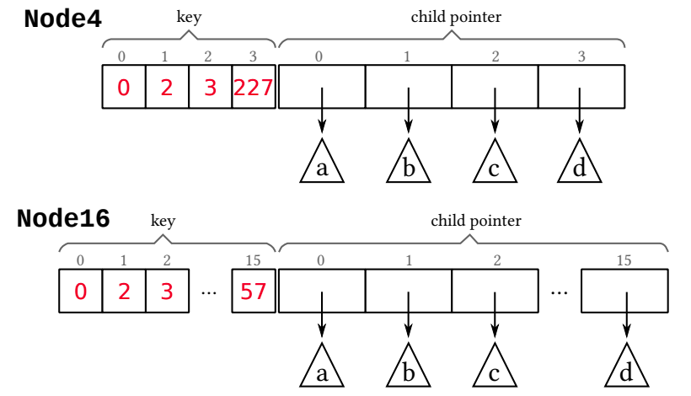
ART – Adaptive Nodes
Source: The adaptive radix tree: ARTful indexing for main-memory databases. IEEE, 2013
Notes:
Node4:
Stores up to 4 child pointers in sorted array
Index is key array is index in pointer array
Keys are sorted
Size: 16+4+4*8 = 52 Byte (16 Byte Header (see later); Cache-Line 64 Byte)
Node16:
Same as Node4 but for 5 – 16 children
Efficient key search with binary search or SIMD
Size: 16+16+16*8 = 160 Byte

Slide 14
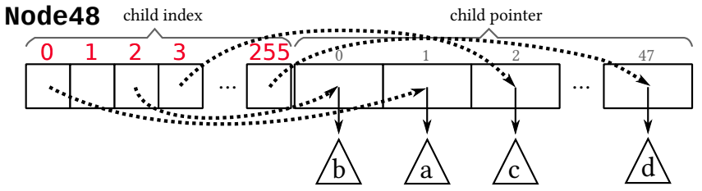
ART – Adaptive Nodes
Source: The adaptive radix tree: ARTful indexing for main-memory databases. IEEE, 2013
Notes:
Node48:
Stores 17 – 48 children
Searching for key is too expensive
-> Use partial key directly as index in index array
Index array holds index (size 1 byte) in pointer array
Size: 16+256+48*8 = 656 Byte

Slide 15
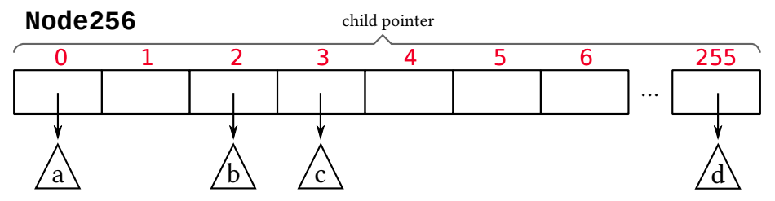
ART – Adaptive Nodes
Source: The adaptive radix tree: ARTful indexing for main-memory databases. IEEE, 2013
Notes:
Node256:
Stores 49 – 256 children
Partial key directly used as index in pointer array
Size: 16+256*8 = 2064 Byte

Slide 16
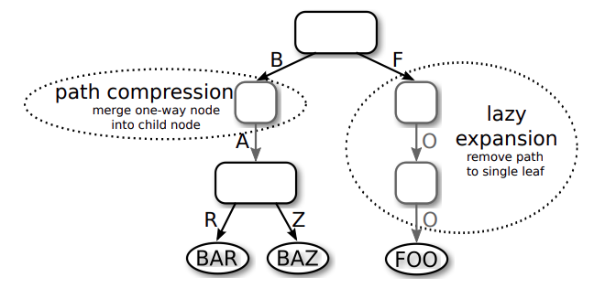
ART – Lazy Expansion
Source: The adaptive radix tree: ARTful indexing for main-memory databases. IEEE, 2013
Notes:
Lazy expansion (insertion):
Only create inner nodes if required to distinguish at least 2 leaf nodes.
Need to be able to retrieve key. Either stored at leaf or from database entry

Slide 17
ART – Path Compression
How to handle omitted partial key?
Pessimistic: store omitted partial key at parent node
Optimistic: only store count of omitted nodes and skip over equivalent key part (compare full key when reaching leaf)
Hybrid approach in ART:
Use pessimistic for size of up to 8 bytes for partial key. Then use optimistic.
Source: The adaptive radix tree: ARTful indexing for main-memory databases. IEEE, 2013
Notes:
Path Compression (Deletion):

Slide 18
Key Transformations for Bitwise Comparisons
How to translate attribute types to make them binary comparible?
a < b ⬄ bin(a) < bin(b) (same for > and =)
Unsigned Integers: Flip byte order for little endian machines
Signed Integers: Flip sign bit (so negative values come before positive ones), store as unsigned integer
Floats: Classify into group (neg vs. Pos, normalized vs. denomarlized, NaN, ∞, 0), store as unsigned integer
Strings: Library functions for Unicode Strings
Null: Identify special value
Compound Type: Transform each attribute separatly, concatenate results
Notes:
As data must be in sorted order we need transformations such that

Slide 19
Store Attributes in Context Sensitive Way
Example: E-Mails from back to front for best compression
bob
john
ada
.com
.de
@tum
@gmail
@gmail
VS.
@gmail
@tum
.de
.com
.com
john
ada
bob
Notes:
Applies to Tries in general.

Slide 20
Memory-Benchmark
Notes:
Own Implementation Memory-Benchmark:
Trie implementation with sparse 16M keys takes more than 16GB (only have 16GB RAM so no value)

Slide 21
Performance-Benchmark (insert)
Notes:
Own Implementation Performance-Benchmark (insert):
(Remove Sorted List as it‘s only bulk insert? Remove for better scale?)
Trie implementation with sparse 16M keys takes more than 16GB (only have 16GB RAM so no value)

Slide 22
Performance-Benchmark (search)
Notes:
Own Implementation Performance-Benchmark (search):
(Hash-Table Performance better than in ART paper? Caching effect? Remove for better scale?)
Trie implementation with sparse 16M keys takes more than 16GB (only have 16GB RAM so no value)

Slide 23
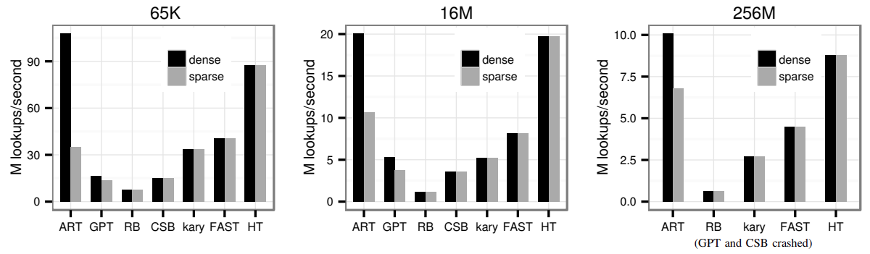
Performance-Benchmark (search)
Source: The adaptive radix tree: ARTful indexing for main-memory databases. IEEE, 2013
Notes:
Own Implementation Performance-Benchmark (search):
(Hash-Table Performance better than in ART paper? Caching effect? Remove for better scale?)
Trie implementation with sparse 16M keys takes more than 16GB (only have 16GB RAM so no value)

Slide 24
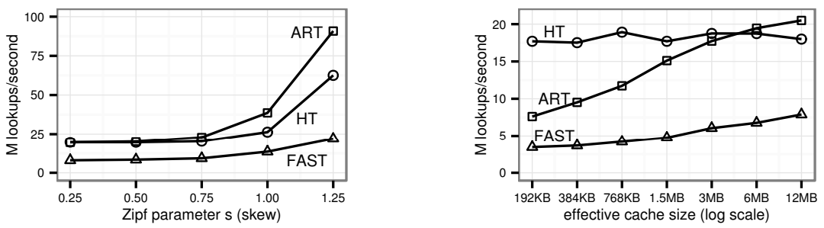
Performance-Benchmark (search, skewed)
Source: The adaptive radix tree: ARTful indexing for main-memory databases. IEEE, 2013
Notes:
Own Implementation Performance-Benchmark (search):
(Hash-Table Performance better than in ART paper? Caching effect? Remove for better scale?)
Trie implementation with sparse 16M keys takes more than 16GB (only have 16GB RAM so no value)

Slide 25
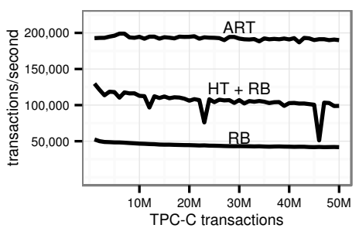
TPC-C Benchmark
Source: The adaptive radix tree: ARTful indexing for main-memory databases. IEEE, 2013
Notes:
Own Implementation Performance-Benchmark (search):
(Hash-Table Performance better than in ART paper? Caching effect? Remove for better scale?)
Trie implementation with sparse 16M keys takes more than 16GB (only have 16GB RAM so no value)

Slide 26
Summary & Conclusion
Advantages & Disadvantages of different index-structures:
 | Range Support | Memory Efficiency | Performance | Researched
B+-Tree | + | − | −− (best for range) | +
ART | + | ∼ | ∼ | ∼
Judy-Array | + | + | − | −
Hash-Table | − | + | + | ∼

Slide 27
Summary & Conclusion
ART used as index-structure in (at least) HyPer
Further research being done:
The ART of practical synchronization (DaMoN, 2016)
HOT: A Height Optimized Trie Index for Main-Memory Database Systems (SIGMOD, 2018)
START – Self-Tuning Adaptive Radix Tree (IEEE, 2020)
(Judy Arrays patent expired this year)

Slide 28
ART – Leaf Nodes
Single-value leaves:
Use extra node type for leaves storing one value
Multi-value leaves:
If value fits into 64 bit (size of a pointer), just store it in pointer arrays of inner nodes instead of the pointer (use 1 bit or pointer tagging to distinguish pointers and values)

Slide 29
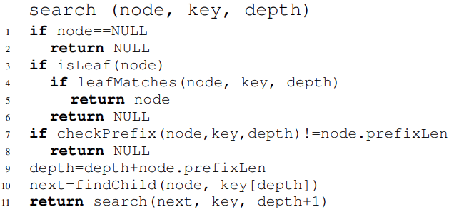
ART – Search
Source: The adaptive radix tree: ARTful indexing for main-memory databases. IEEE, 2013

Slide 30
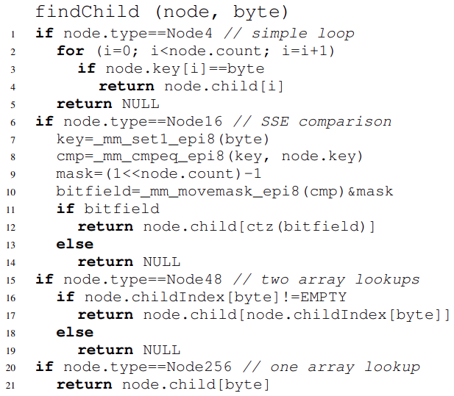
ART – Search
Source: The adaptive radix tree: ARTful indexing for main-memory databases. IEEE, 2013

Slide 31
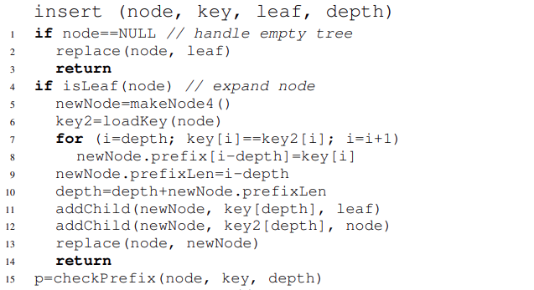
ART – Insert
Source: The adaptive radix tree: ARTful indexing for main-memory databases. IEEE, 2013

Slide 32
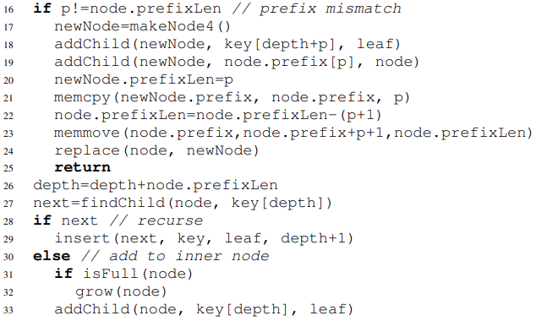
ART – Insert
Source: The adaptive radix tree: ARTful indexing for main-memory databases. IEEE, 2013

Slide 33
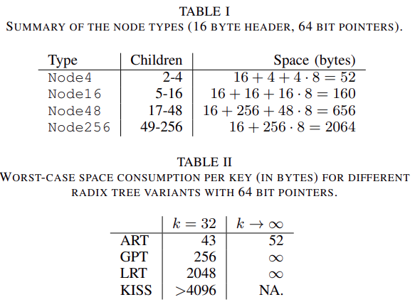
ART – Space Consumption
Source: The adaptive radix tree: ARTful indexing for main-memory databases. IEEE, 2013

Slide 34
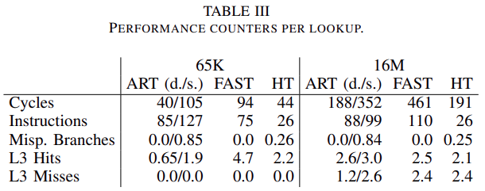
Performance-Benchmark (search)
Source: The adaptive radix tree: ARTful indexing for main-memory databases. IEEE, 2013
Notes:
Own Implementation Performance-Benchmark (search):
(Hash-Table Performance better than in ART paper? Caching effect? Remove for better scale?)
Trie implementation with sparse 16M keys takes more than 16GB (only have 16GB RAM so no value)

Slide 35
ART – Space Consumption
Source: The adaptive radix tree: ARTful indexing for main-memory databases. IEEE, 2013

Slide 36
Even More Benchmarks
See:
A Comparison of Adaptive Radix Trees and Hash Tables (IEEE, 2015)
Building a Bw-Tree Takes More Than Just Buzz Words (SIGMOD, 2018)

Slide 37
T E M P L A T E S L I D E S
Dr. rer. nat. Erika Mustermann
München, 27. März 2015

Slide 38
Dr. rer. nat. Erika Mustermann
München, 27. März 2015

Slide 39
Dr. rer. nat. Erika Mustermann
München, 27. März 2015

Slide 40
Gültigkeit der Masterfolien
Dieser Folienmaster gilt bei offiziellen Präsentationen im Rahmen der TUM. Es ist darauf zu achten, dass wir uns in einem durchgängigen Layout präsentieren.
Abweichungen vom vorgegebenen Layout bitte auf ein Minimum reduzieren.

Slide 41
Grundlage der Masterfolien
Als Grundlage dient der Corporate Design Style Guide der TUM. Die Präsentationsvorlage ist auf gute Lesbarkeit und klare Darstellung von Informationen optimiert.

Slide 42
Hier steht eine Überschrift max. 2-zeilig
Als Grundlage dient der Corporate Design Style Guide der TUM. Die Präsentationsvorlage ist auf gute Lesbarkeit und klare Darstellung von Informationen optimiert.

Slide 43
Schrift
Das Grundprinzip ist, Informationen bestmöglich zu transportieren. Dazu muss vor allem die Schrift einheitlich und für alle im Raum lesbar sein.
Schriftart: Arial
Schriftgrößen:30 | 22 | 16 | 12
Zeilenabstand: 1,15mm
Die Einstellungen sind in den Textfeldern und Textfeldvorlagen dieses ppt-Masters als Standard eingestellt. Bei Diagrammen und Tabellen muss die Schriftgröße ggf. angepasst werden. Für Auszeichnungen im Fließtext kann auch fett markiert werden.
Bei großer Distanz bzw. kleinem Präsentationsmedium kann der Schriftgrad notfalls proportional erhöht werden.

Slide 44
Farben
Als erstes soll mit schwarz und weiß gearbeitet werden. Für Aufwändigere Darstellungen sind Farben mit Bedacht und in möglichst geringem Umfang einzusetzen.
In diesem Folienmaster ist die Farbpalette festgelegt.
Zuerst mit den Primärfarben arbeiten.
Für z.B. komplexe Diagramme stehen nochSekundärfarben zur Verfügung.
Gering im Einsatz sind die Akzentfarben.

Slide 45
Texte
Kurze und knappe Texte, Fließtexte linksbündig, kein Blocksatz
Beispiel:
Tem soluptam, nisi as verum ereprehendam at acculpa quidisq uissit volupta tusdant utem as etur, odi odis es doluptiae dem nimaion con nossinctenis pora quam voloria consenimus blabore everfer epeliquo maio etur.

Slide 46
Aufzählung
Bei kleinen Aufzählungen auf Aufzählungszeichen verzichten und ggf. zusätzliche Leerzeile
Nur die wesentlichen Punkte nennen und Themen auf verschiedene Seiten splitten.
Punkt 1
Punkt 2
Wenn Unterpunkte in einer Aufzählung nötig sind ist ein Einrücken mit – möglich
Unterpunkt 1
Unterpunkt 1
Unterpunkt 2
Bei größeren Listen die Standardeinstellung • verwenden
Unterpunkt 1
Unterpunkt 2
Unterpunkt 3

Slide 47
Bilder - Allgemein
schlichte Darstellung von Informationen
reduzierte Farben
Rahmen und Überlagerungen nach Möglichkeit vermeiden

Slide 48
Bilder
Bildbeschreibung oberer Bildrand: Begrenzung durch Text

Slide 49
Bilder
Überschrift 2
Hier steht ein einleitender oder beschreibender Fließtext und nach Wunsch eine Aufzählung
Punkt 1
Punkt 2
Punkt 3
Punkt 4

Slide 50
Bilder
Bildbeschreibung oberer Bildrand: Begrenzung durch Text

Slide 51
Bilder
Bildbeschreibung oberer Bildrand: Begrenzung durch Text

Slide 52
Nicht formatfüllende Bilder
Weißer bzw. transparenter Hintergrund mit genug Freiraum anordnen

Slide 53
Bilder Format füllend - maximale Bildgröße

Slide 54
Nicht Format füllende Bilder
Alternativ mit formatfüllendem Hintergrund: 5 % schwarz
Beschriftungen können zusätzlich neben den Bildern angebracht werden
Bilderklärung

Slide 55
Tabelle – Beispiel 1
Tabelle ohne Farbe und kein Rand innerer Seitenrand links 0 cm, oben z.B. 0,5 cm (für genug Zeilenabstand innerhalb)
Ø - Strecke | 39 km/Tag (14.360 km/Jahr)
Ø - Geschwindigkeit | 25 km/h
Ø - Verfügbare Ladezeit | 22 h/Tag
Kosten | Kleinwagen mit Verbrennungsmotor
Einsatzgebiet | Stadt und Umland

Slide 56
Tabelle – Beispiel 2
Tabelle mit schwarzem Rand innerer Seitenrand links 0,15 cm, oben z.B. 0,5 cm (für genug Zeilenabstand innerhalb)
Ø - Strecke | 39 km/Tag (14.360 km/Jahr)
Ø - Geschwindigkeit | 25 km/h
Ø - Verfügbare Ladezeit | 22 h/Tag
Kosten | Kleinwagen mit Verbrennungsmotor
Einsatzgebiet | Stadt und Umland

Slide 57
Diagramme – Beispiel 1
Nach Möglichkeit linksbündig bleiben Unnötige Striche und Balken vermeiden

Slide 58
Diagramme

